Slide 1
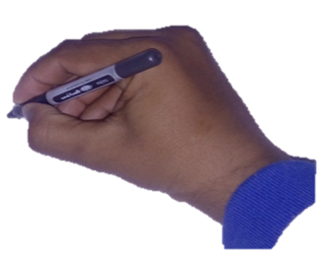
SAFETY CAMPAIGN
IMPORTANT RULES FOR SAFE DRIVING
MAETEL
Safe Drive
Construction of substation 8238 for Wadi
Safar project Riyadh KSA
Prepared By: Aamir Khan
Save Life

Slide 2

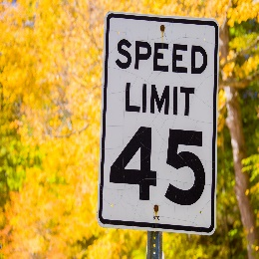
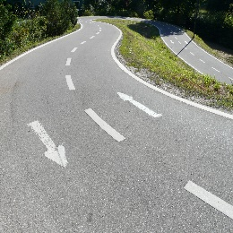
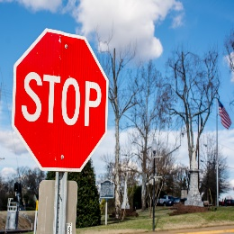

1. Follow Traffic Laws
Adhere to posted speed limits, traffic signals
1
Maetel
road signs, and lane markings
Safe Drive
Save Life

Slide 3
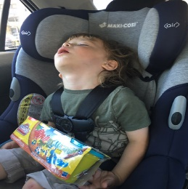

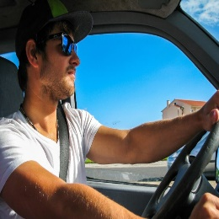
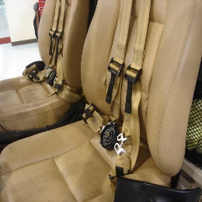
2. Wear Seat Belts
Always wear a seat belt and ensure all
2
Maetel
passengers are properly secured.
Safe Drive
Save Life
This Photo by Unknown Author is licensed under CC BY-SA
This Photo by Unknown Author is licensed under CC BY-SA
This Photo by Unknown Author is licensed under CC BY-SA

Slide 4
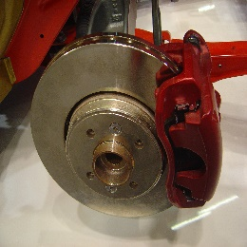
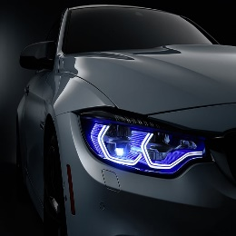
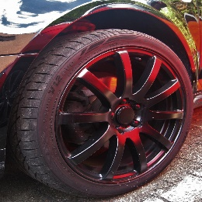
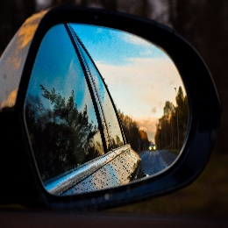
3. Maintain Vehicle Condition
Regularly inspect and maintain your vehicle,
3
Maetel
including brakes, tires, lights, and mirror
Safe Drive
Save Life
This Photo by Unknown Author is licensed under CC BY-SA

Slide 5
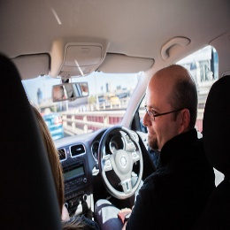
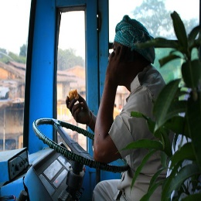
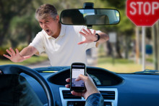
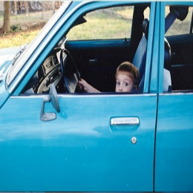
4. Avoid Distractions
Avoid using mobile phones, eating, or engaging
4
Maetel
in any other distracting activities while driving
Safe Drive
Save Life

Slide 6
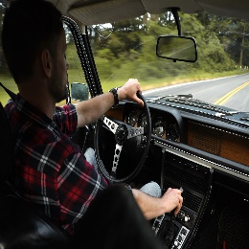
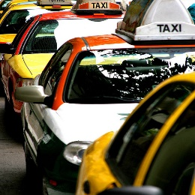
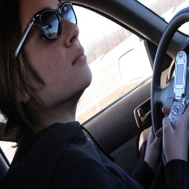
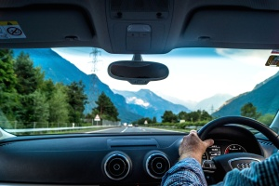
5. Stay Focused
Stay mentally present and focused on the road,
5
Maetel
other drivers, and potential hazards
Safe Drive
Save Life

Slide 7
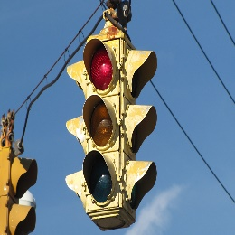
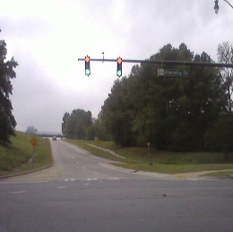
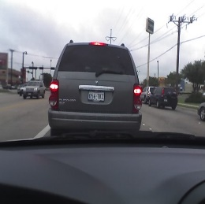
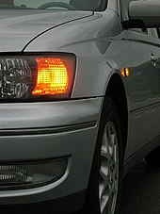
6. Use Turn Signals
Signal your intentions early to indicate lane
6
Maetel
changes, turns, or merging
Safe Drive
Save Life

Slide 8
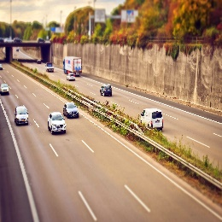
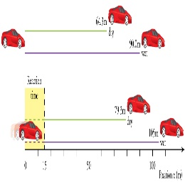
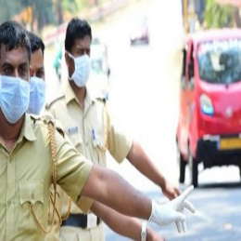
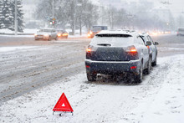
7. Maintain Distance
Keep a safe distance from the vehicle ahead to
7
Maetel
allow for proper reaction time
Safe Drive
Save Life

Slide 9
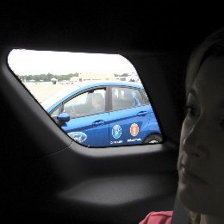
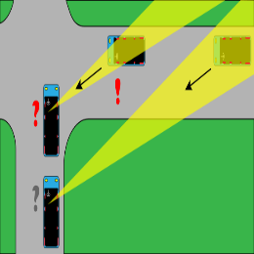
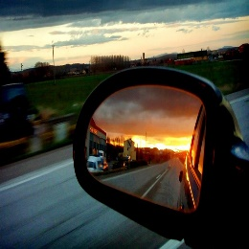
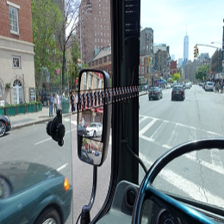
8. Check Blind Spots
Frequently check blind spots when changing
8
Maetel
lanes or merging to avoid collisions
Safe Drive
Save Life

Slide 10
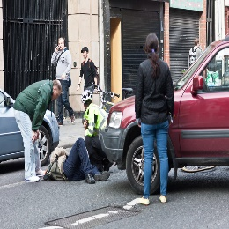
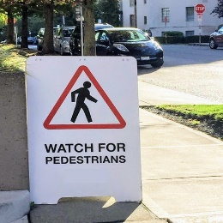
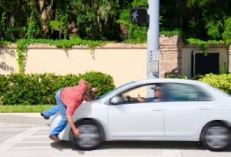

9. Observe Pedestrians
Yield to pedestrians, especially at crosswalks,
9
Maetel
and be vigilant in school zones or crowded areas
Safe Drive
Save Life

Slide 11

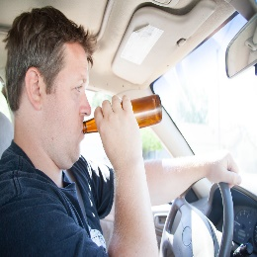
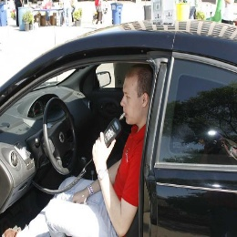

10. Don't Drink and Drive
Never operate a vehicle under the influence of
10
Maetel
alcohol or drugs. Designate a sober driver or
use alternative transportation
Safe Drive
Save Life

Slide 12

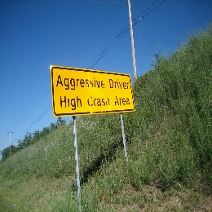

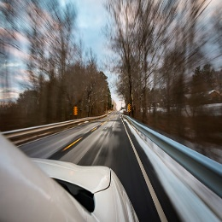
11. Avoid Aggressive Driving
Refrain from tailgating, excessive speeding
11
Maetel
honking, or aggressive maneuvers
Safe Drive
Save Life

Slide 13
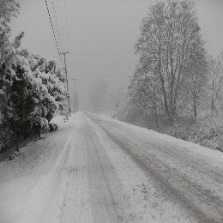
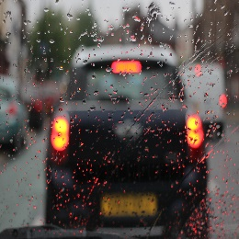
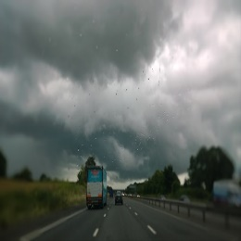
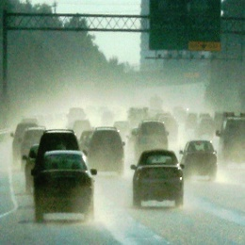
12. Be Aware of Weather Conditions
Adjust your driving according to weather
12
Maetel
Conditions, such as rain, snow, or fog.
Slow down and maintain a safe distance
Safe Drive
Save Life

Slide 14
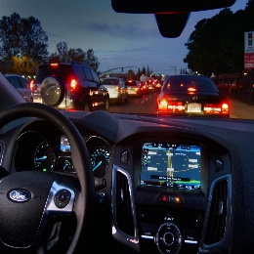
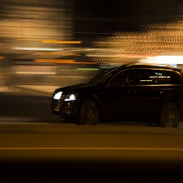
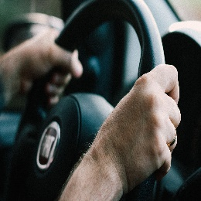

13. Maintain Focus at Night
Use appropriate headlights, drive defensively,
13
Maetel
and be extra cautious in low-light conditions
Safe Drive
Save Life

Slide 15
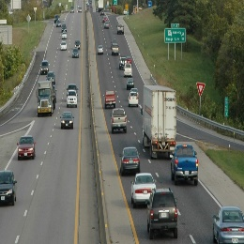
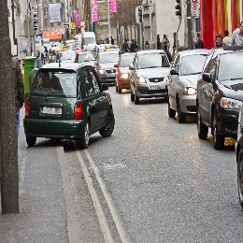
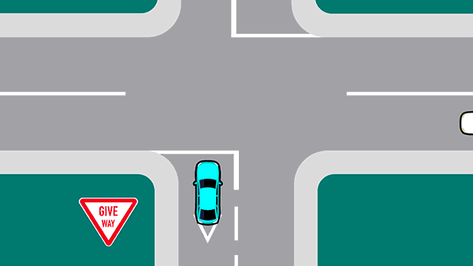
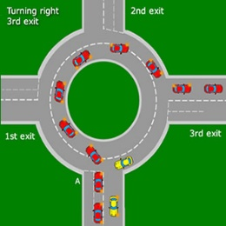
14. Yield Right of Way
Understand and adhere to right-of-way laws
14
Maetel
to prevent accidents at intersections
Safe Drive
Save Life

Slide 16
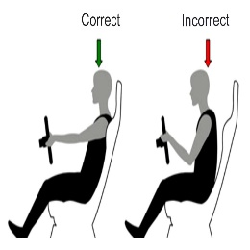



15. Stay Calm in Traffic
Avoid road rage incidents, remain patient,
15
Maetel
and practice defensive driving techniques
Safe Drive
Save Life

Slide 17
THANK YOU
10
Maetel
Click
SUBSCRIBE

