Slide 1


IMPORTANCE OF VEHICLE MAINTENANCE
SAFETY CAMPAIGN
Maetel Saudi Arabia
Construction of Substation 8238 for Wadi Safar Project Riyadh KSA
Prepared by: Aamir khan

Slide 2
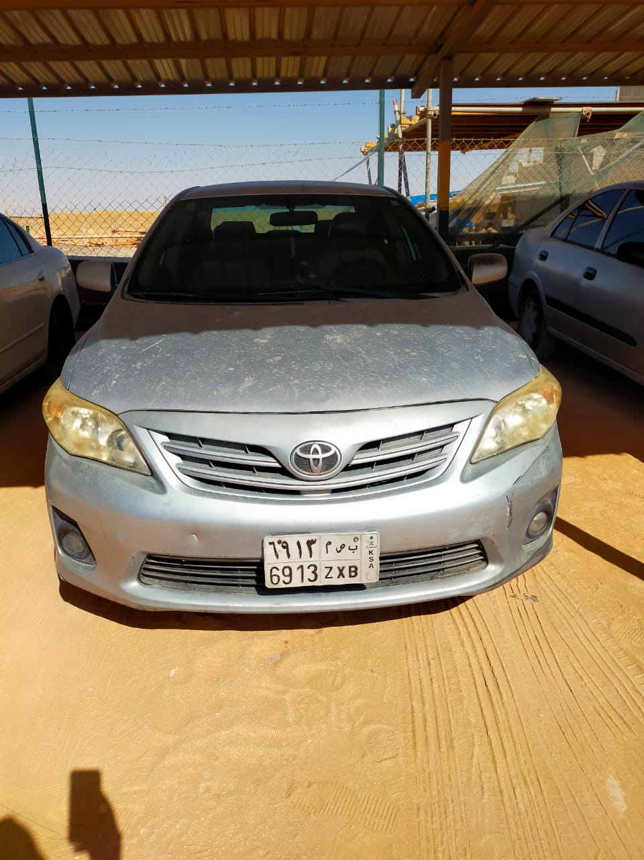
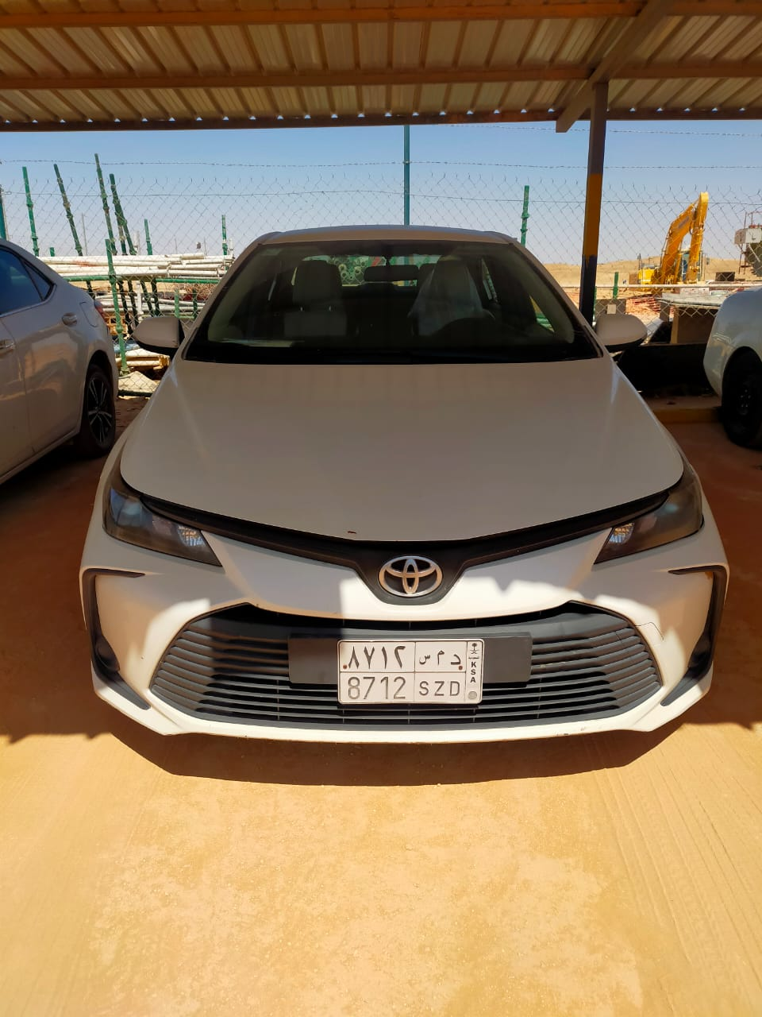
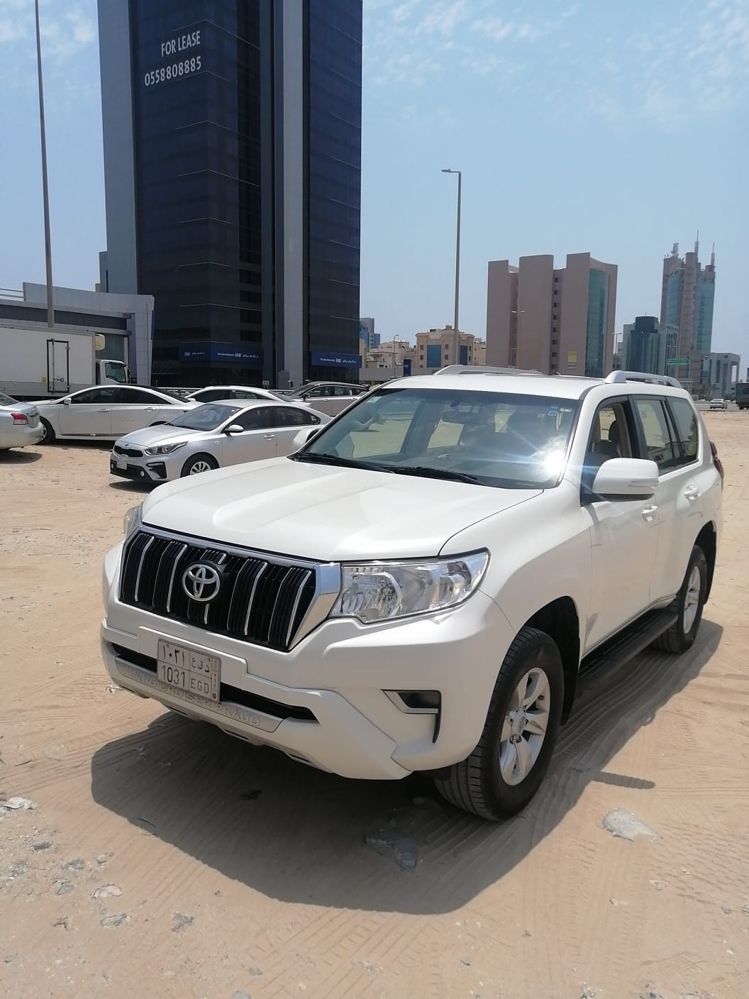
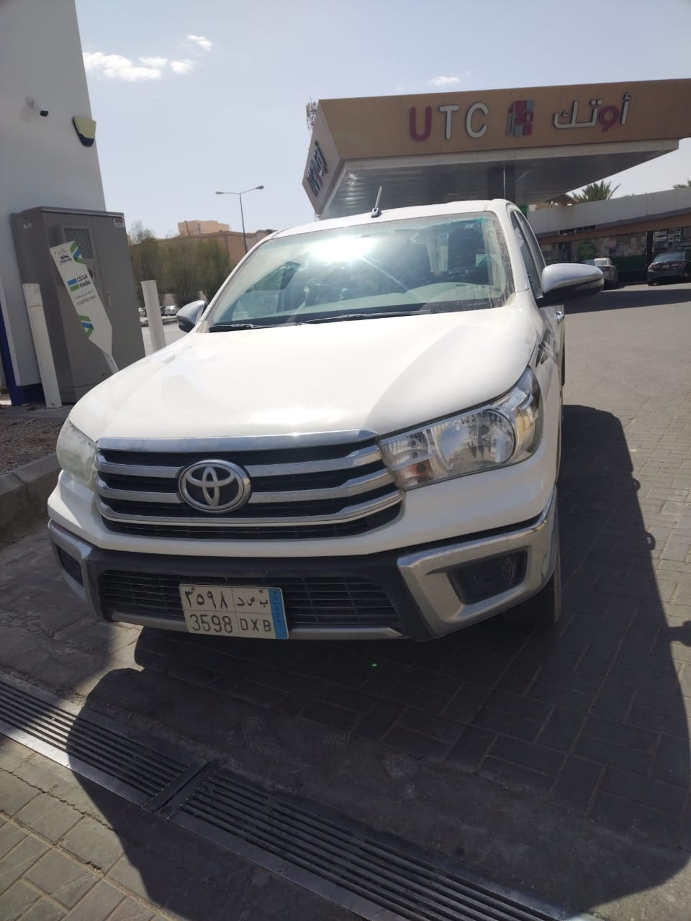
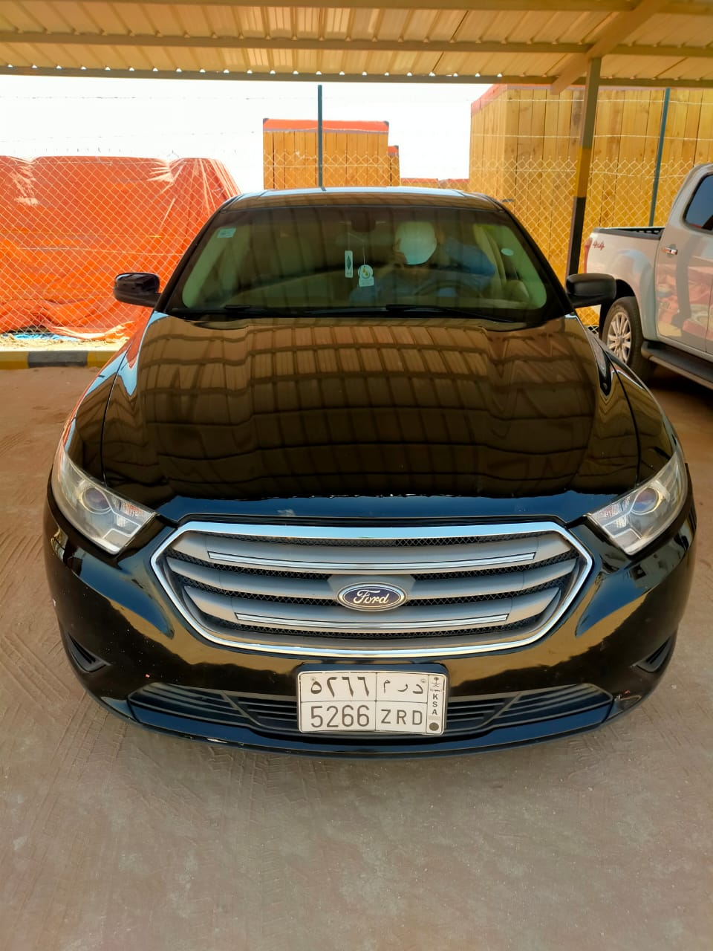
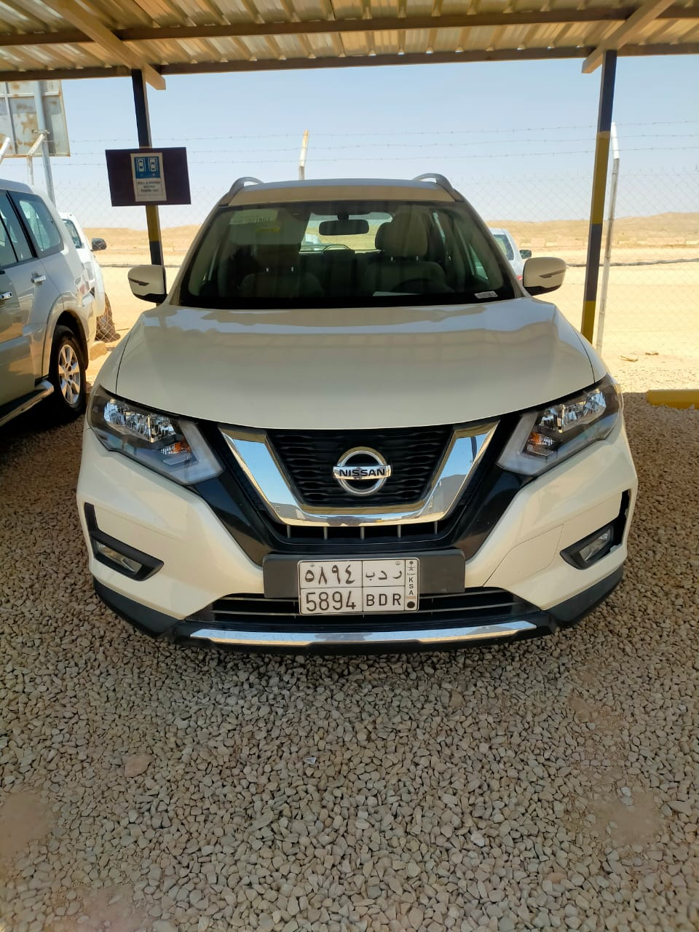
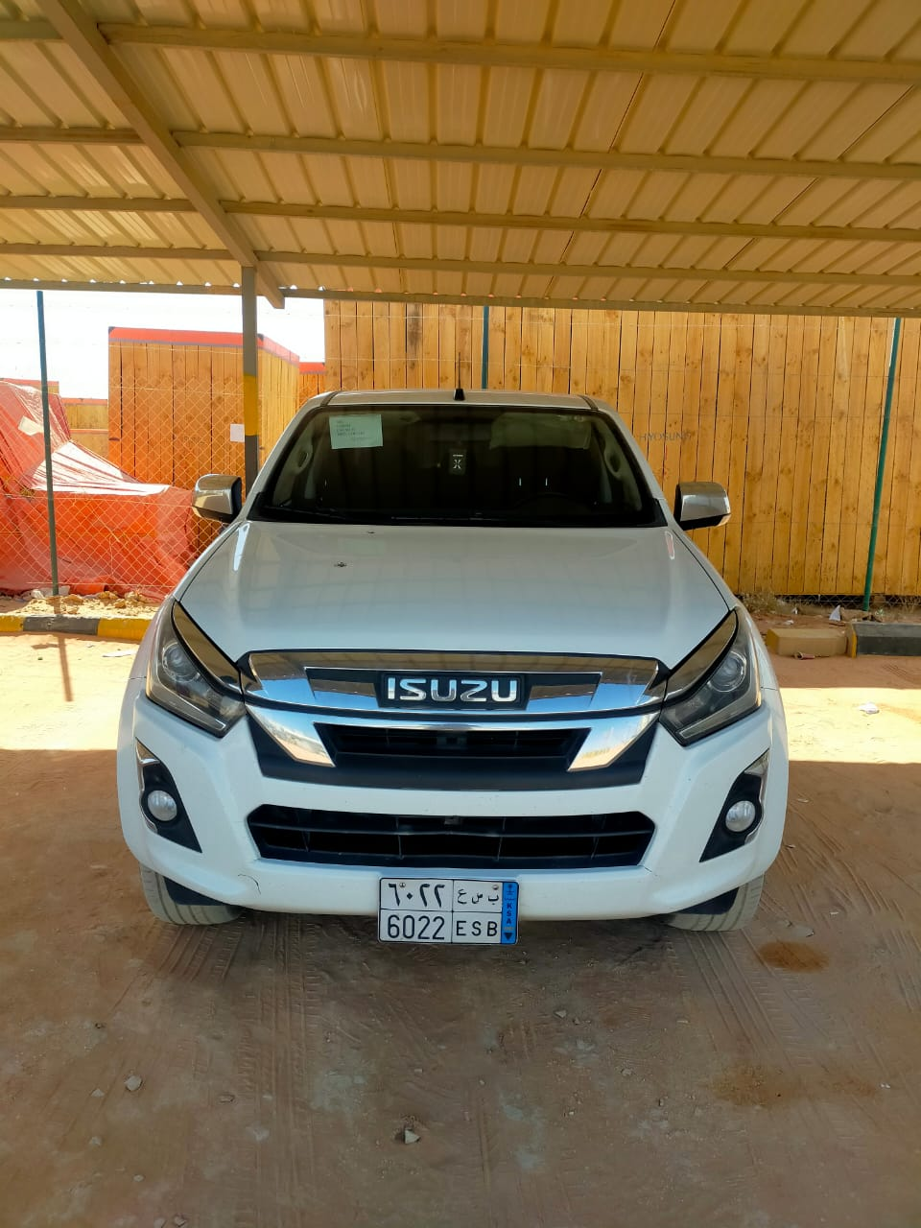
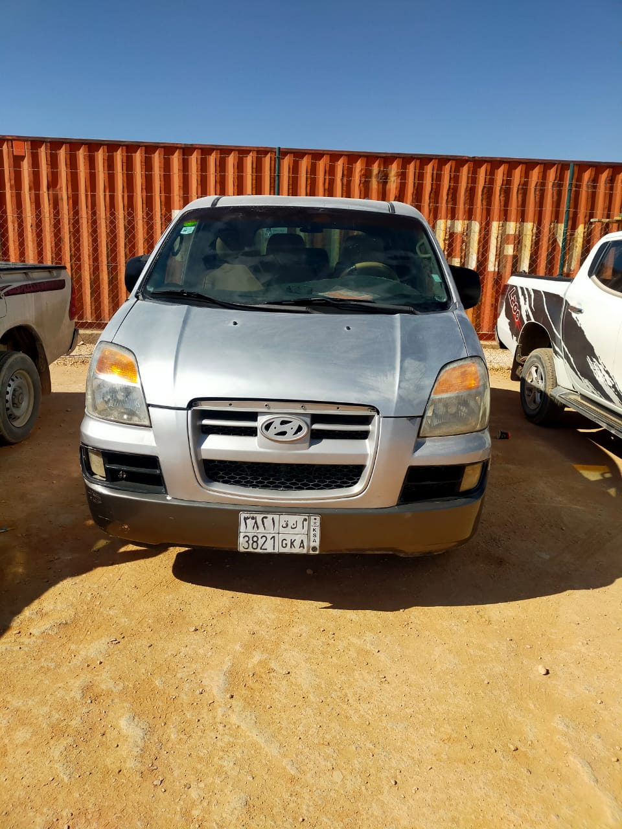
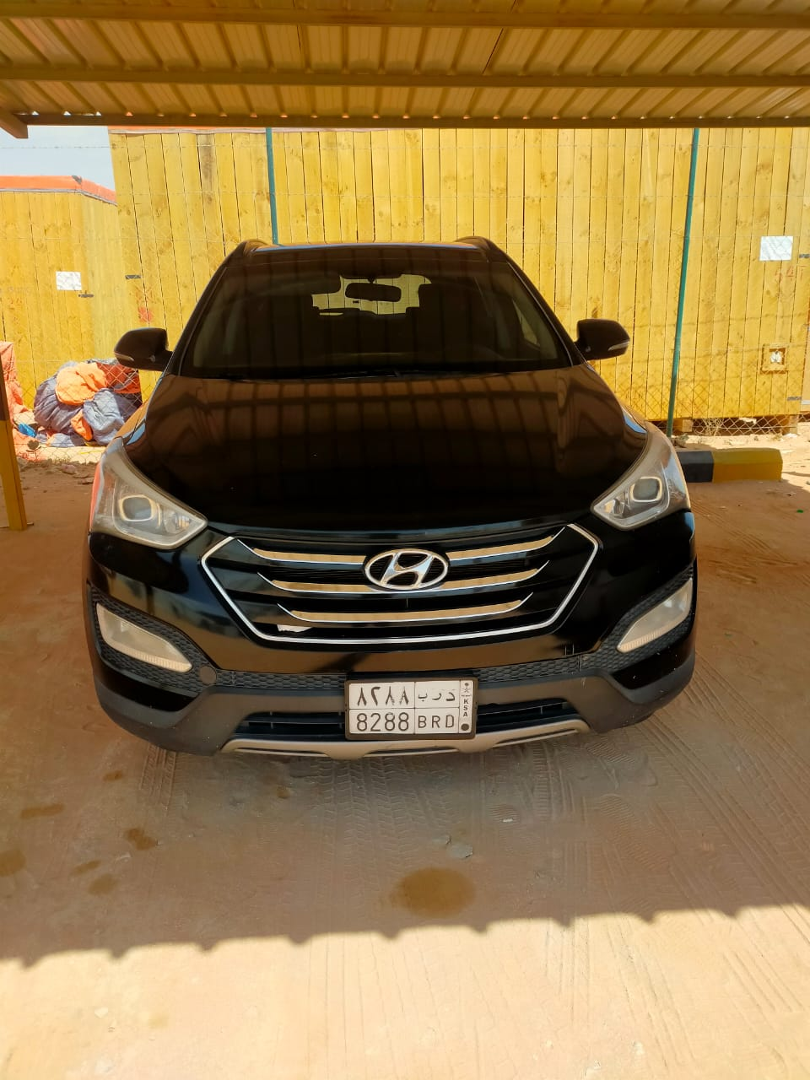
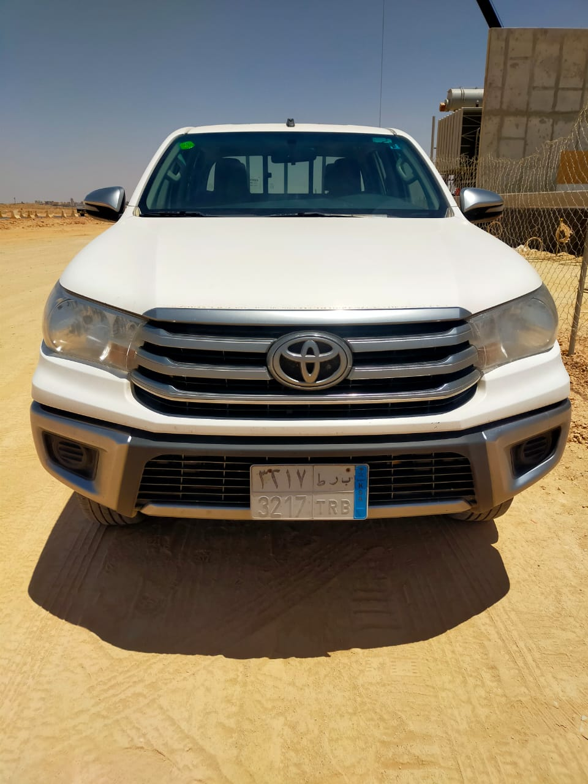
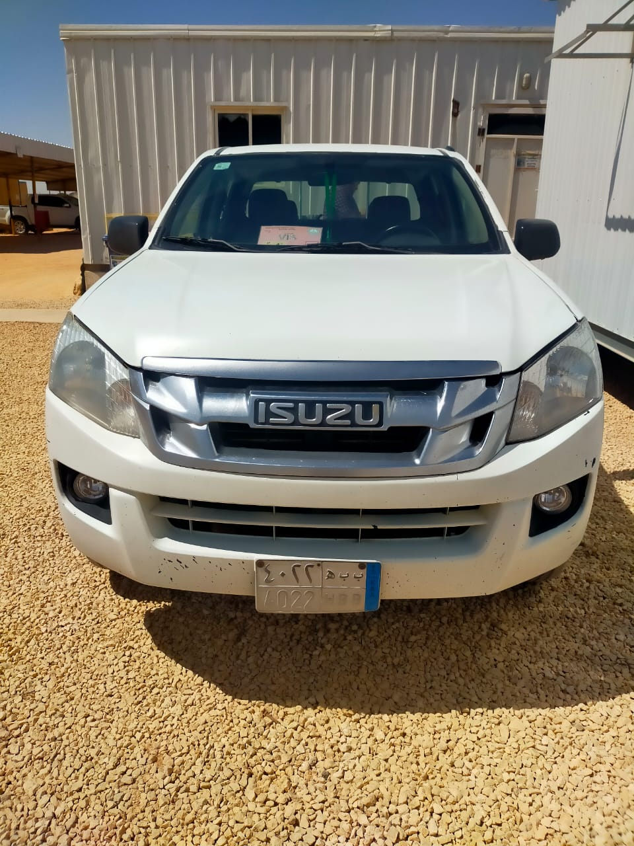
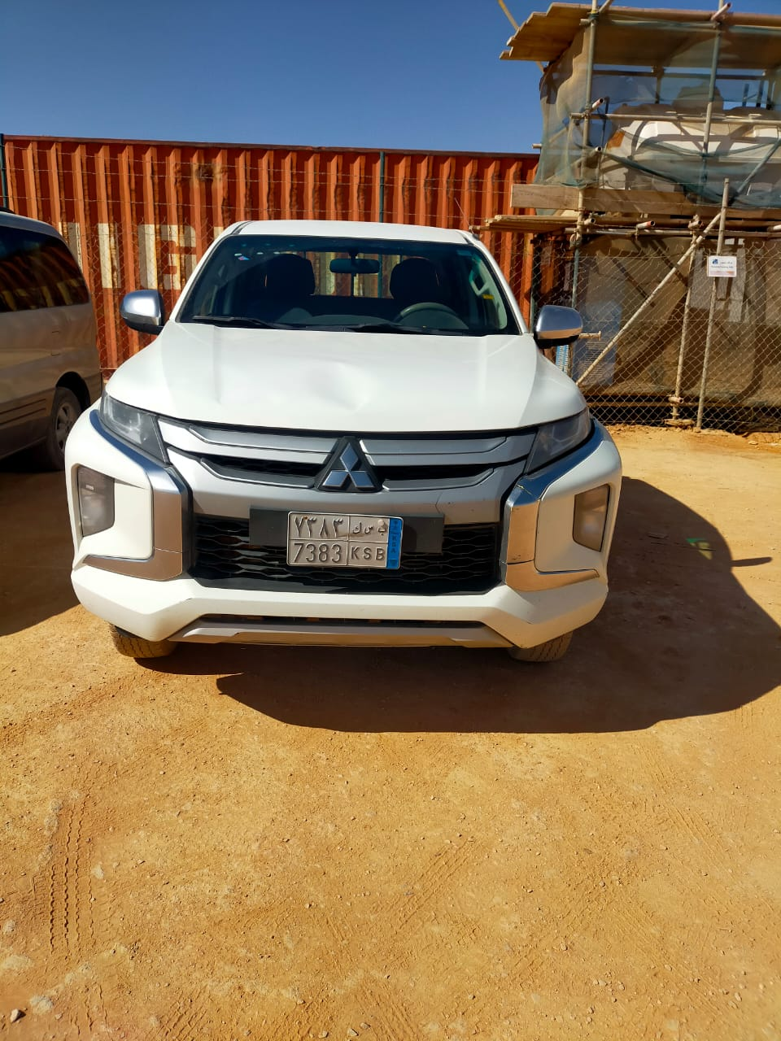
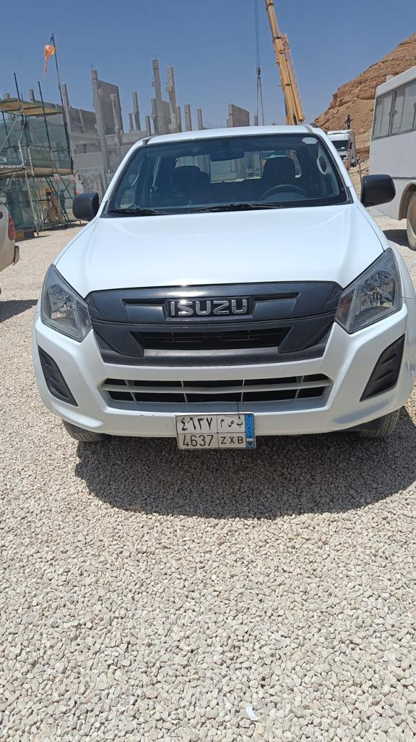
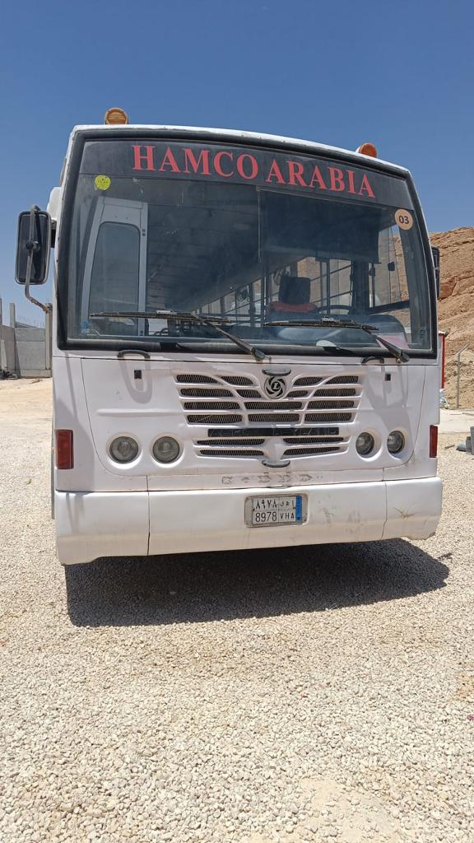
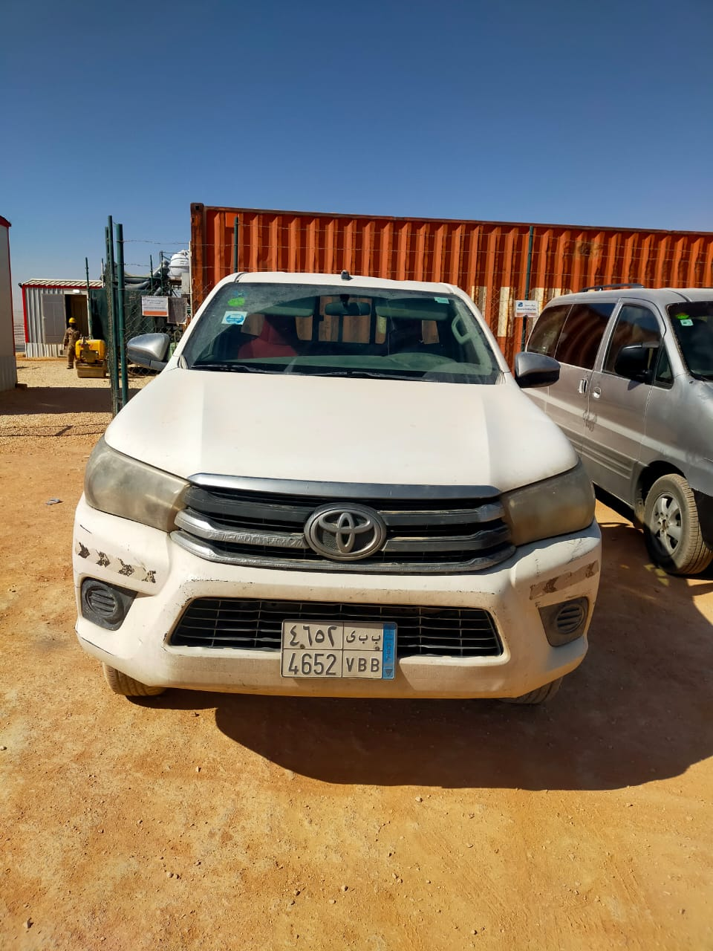
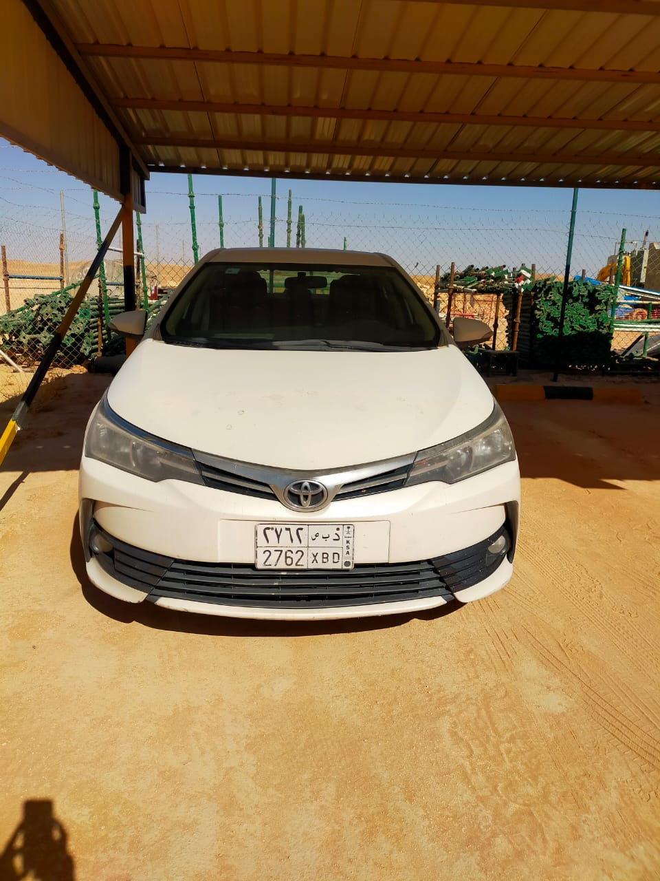
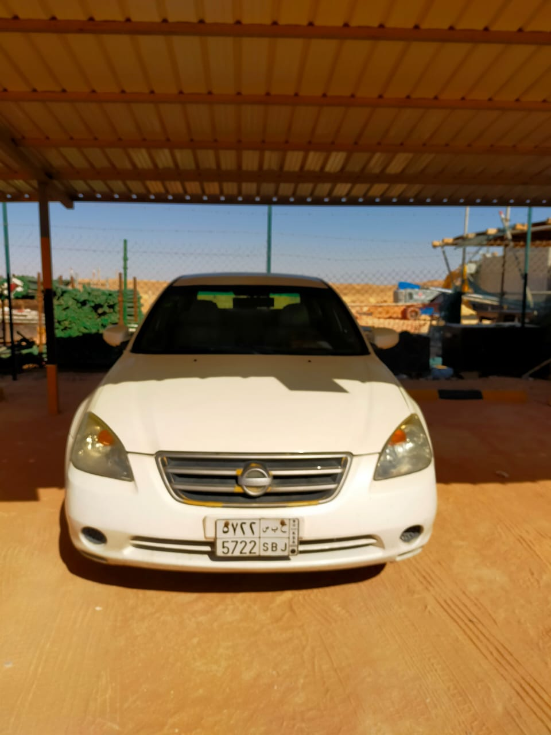
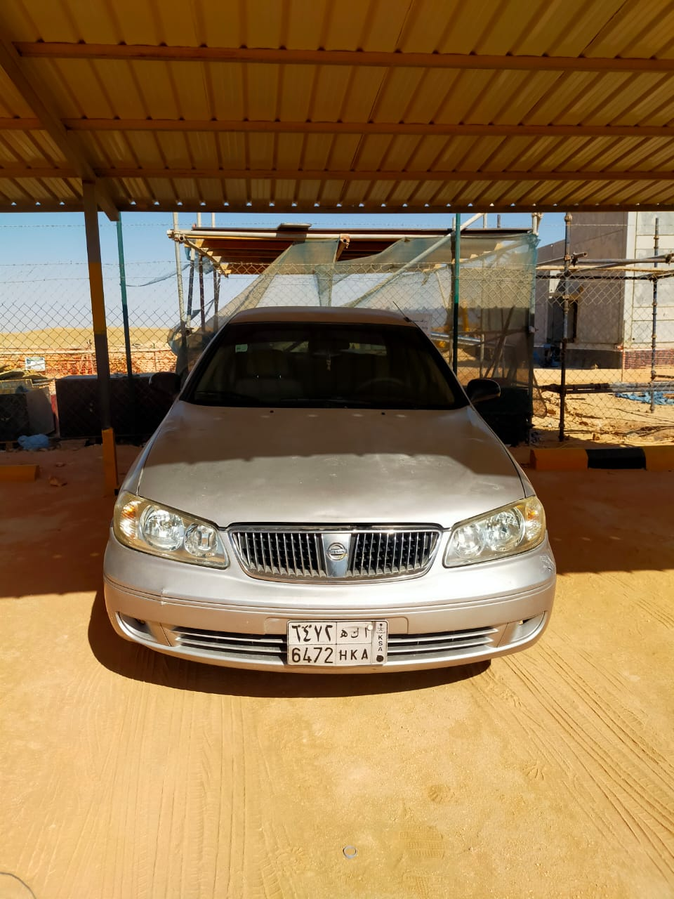
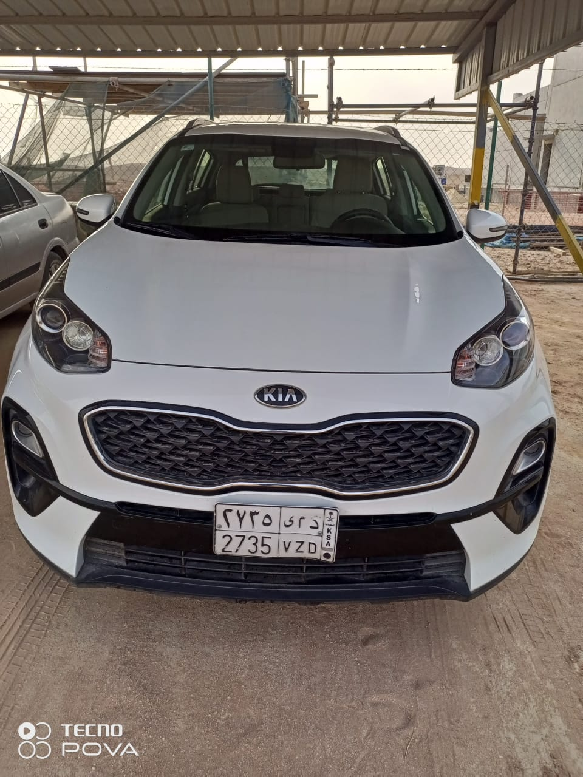
LIST OF VEHICLES
PRAINSA
SEC
SECURITY
TOP HARDNESS
HAMCO
MAETEL KSA
5266 ZRD (FORD)
5266 ZRD (FORD)
6022 ESB (ISUZU)
3821 GKA (HYUNDAI)
7383 KSB MITSUBISI
1031 EGD (PRADO)
5894 BDR (NISSAN)
8288 BRD (HONDA)
3217 TRB (NISSAN)
4637 ZXB (ISUZI)
2762 XBD (TOYOTA)
4022 HBB (ISUZU)
8978 VHA (ASHOK)
8712 SZD (TOYOTA)
4652 VBB (NISSAN)
6913 ZXB (TOYOTA)
5722 SBJ (NISSAN)
6472 HKA (NISSAN)
2735 VZD (KIA)

Slide 3
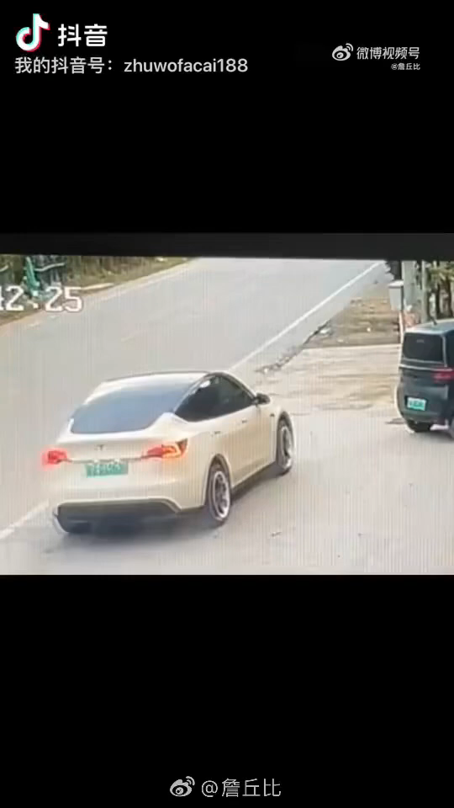
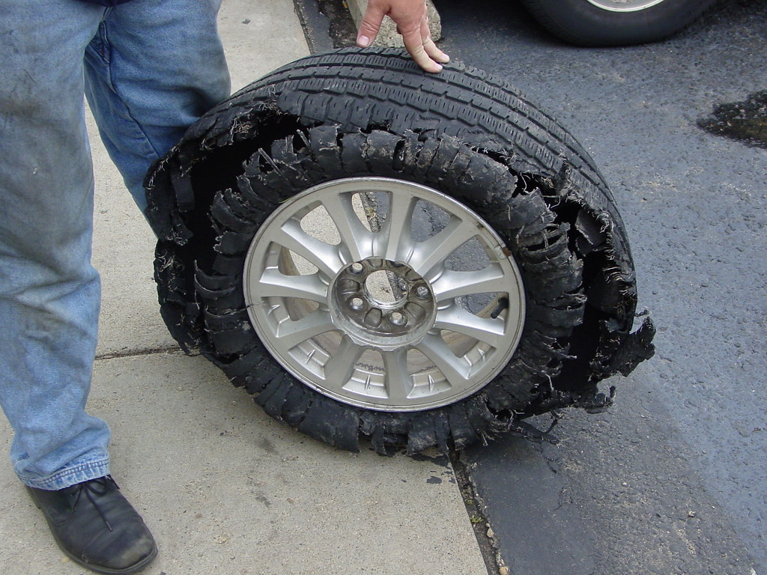
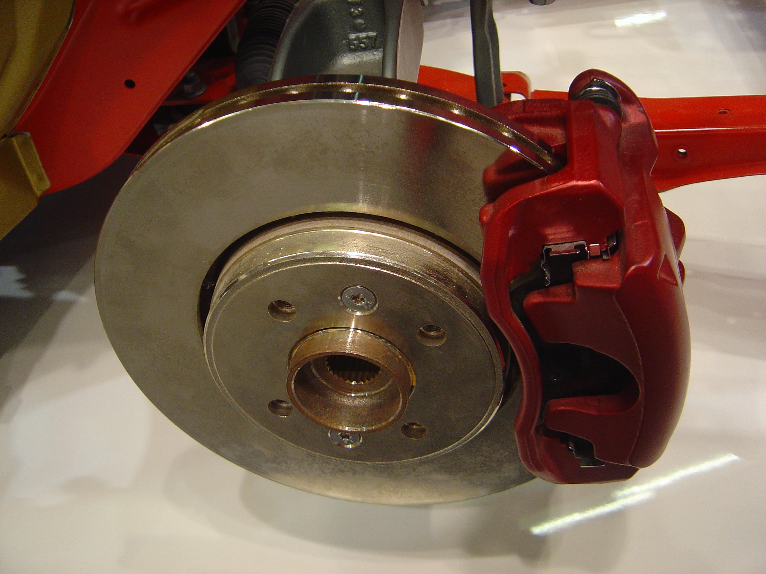
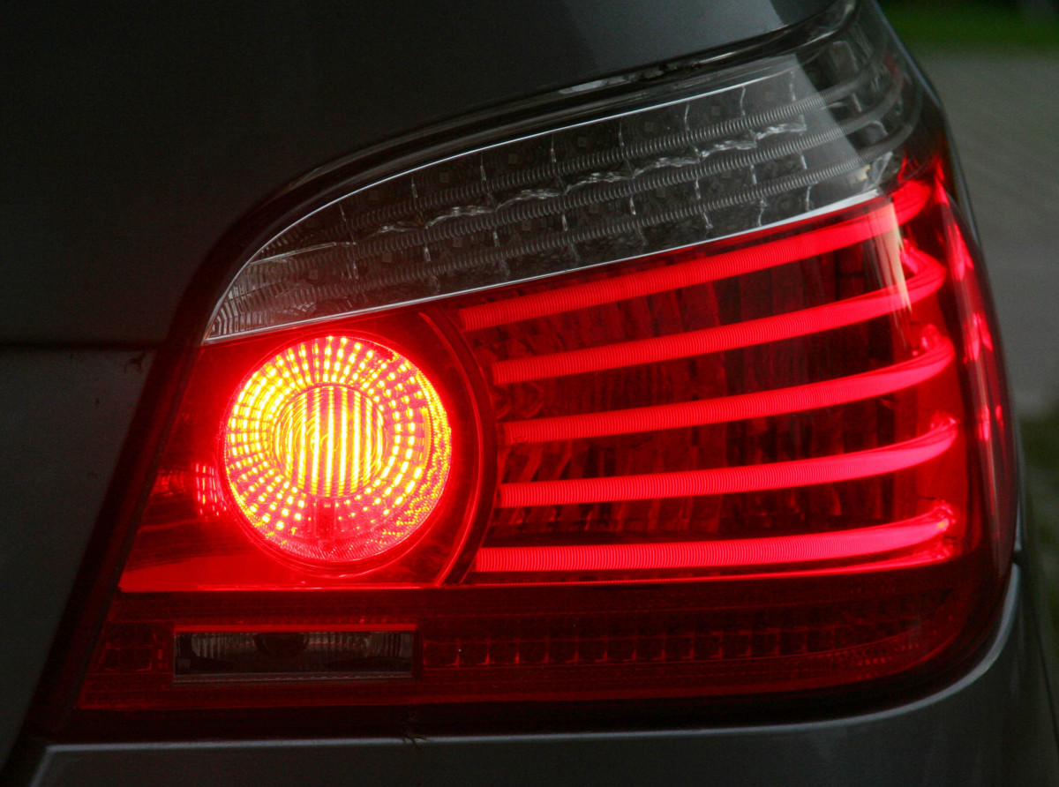
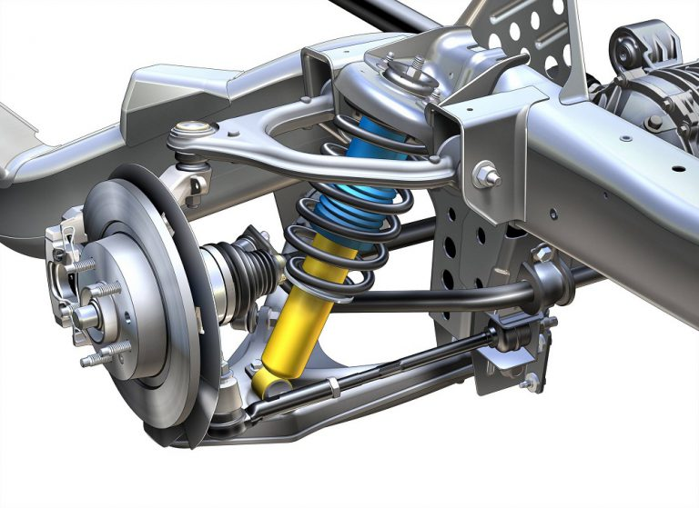
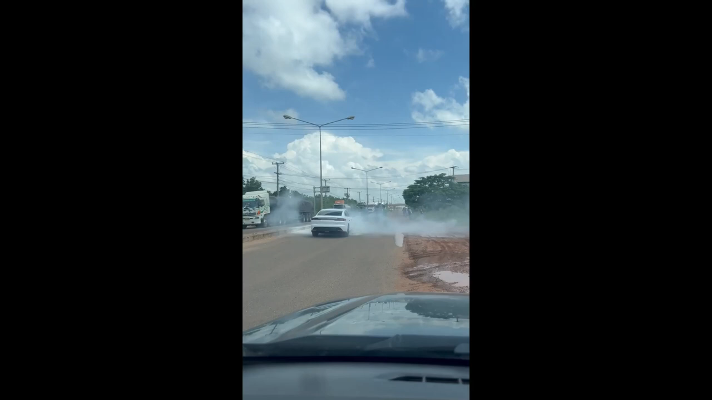
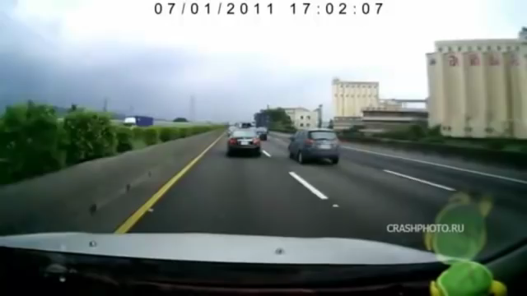
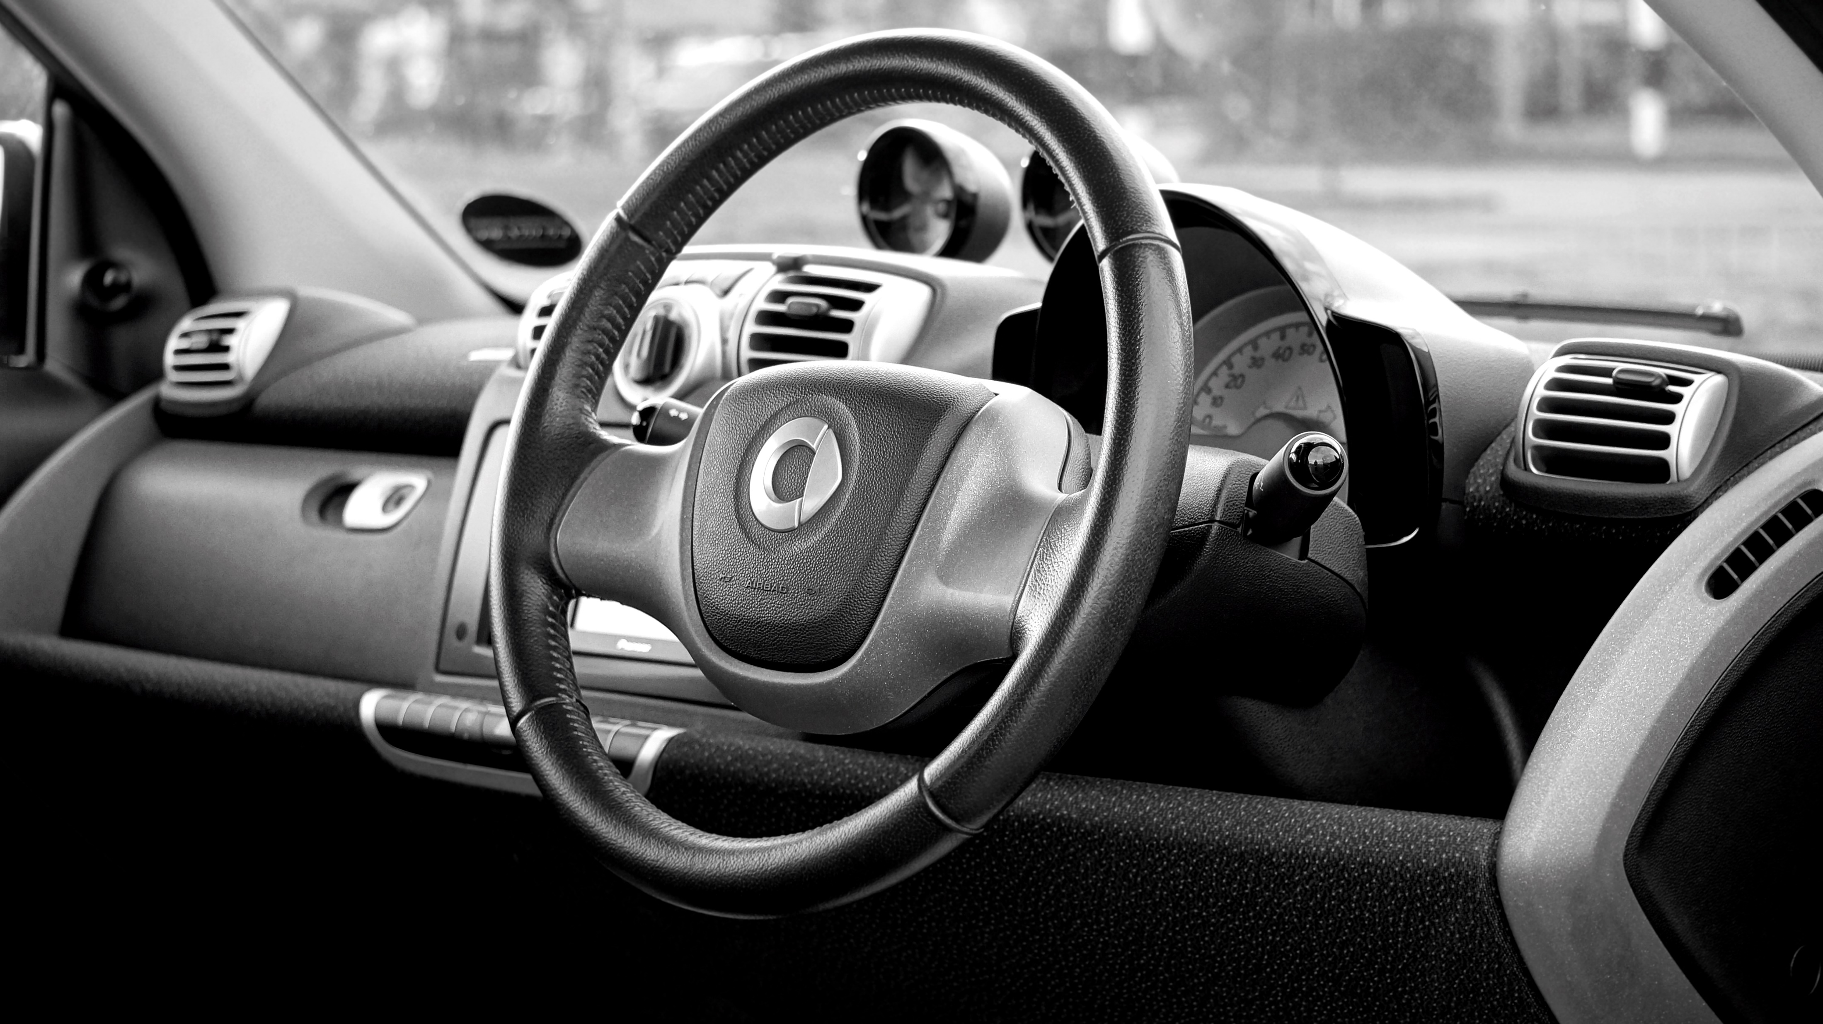
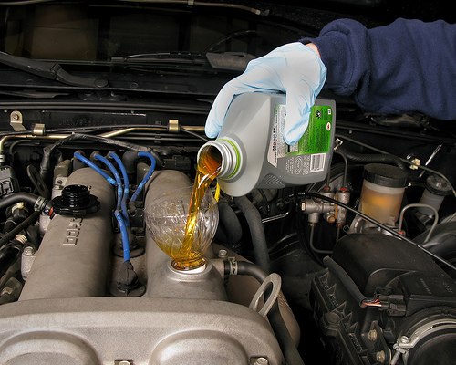
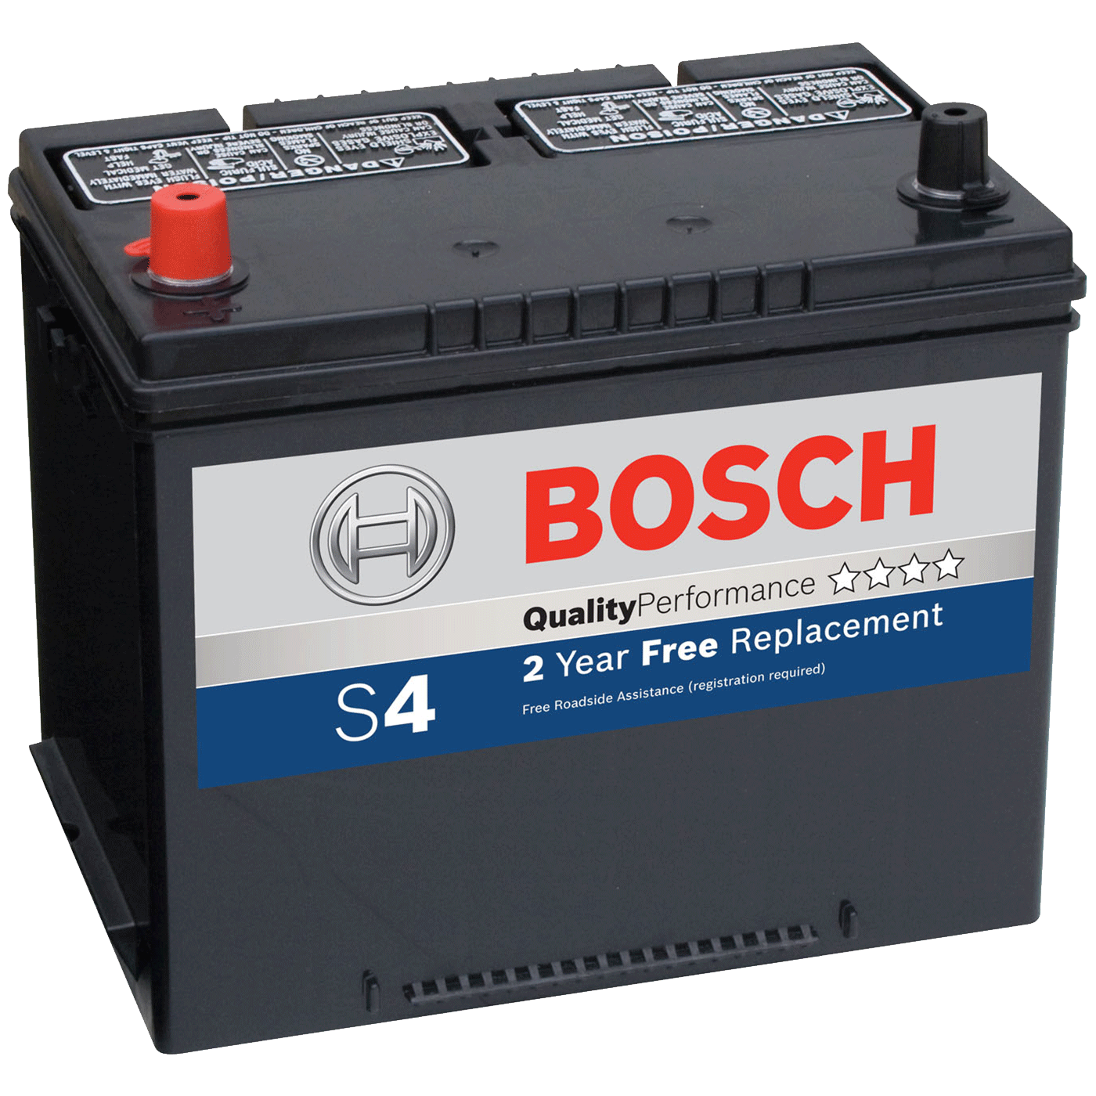
Parts of the vehicle, if not maintained could lead to accidents
TIRES
BRAKES
LIGHTS
SUSPENSION SYSTEM
STEERING SYSTEM
BATTERY
FLUID LEVELS
TIRES
Broken or malfunctioning lights, such as headlights, taillights, or turn signals, can impair visibility and increase the risk of collisions, especially during nighttime or adverse weather conditions
Neglected suspension components can cause the vehicle to be unstable, affecting handling and control, particularly during turns or sudden maneuvers
Failing to maintain adequate levels of engine oil, transmission fluid, brake fluid, or coolant can result in mechanical failures, leading to accidents or breakdowns
A weak or dead battery can cause unexpected stalling or failure to start, potentially leading to accidents, especially in critical situations like driving on busy highways
Issues with the steering system, such as loose or worn-out parts, can lead to a loss of control over the vehicle, resulting in accidents
Worn-out or underinflated tires can reduce grip and traction, leading to skidding and loss of control.
Poorly maintained brakes can fail to bring a vehicle to a stop when necessary, resulting in accidents or collisions.
BRAKES
LIGHTS
SUSPENSION SYSTEM
STEERING SYSTEM
FLUID LEVELS
BATTERY

Slide 4
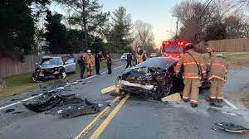
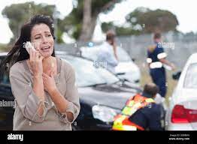




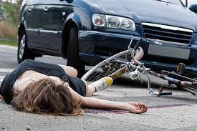
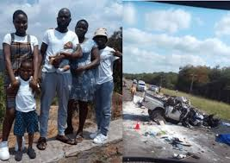
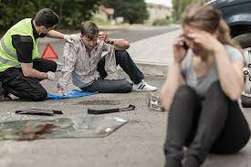
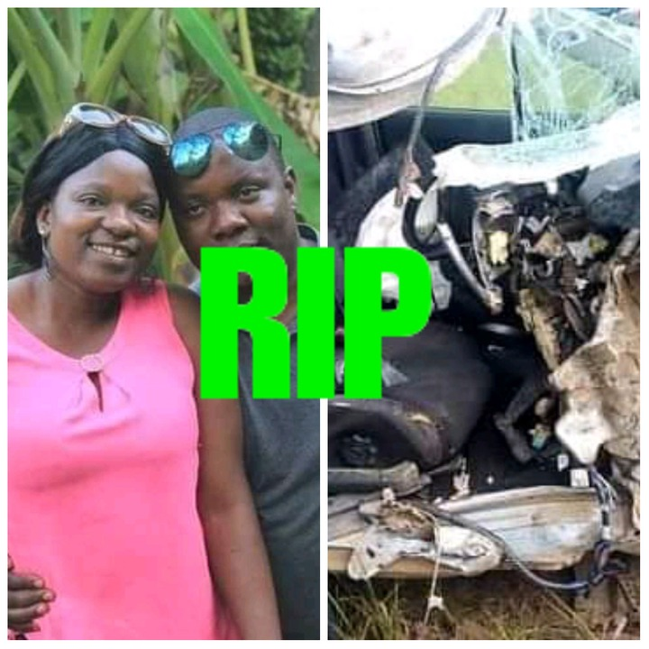
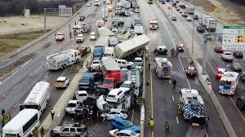

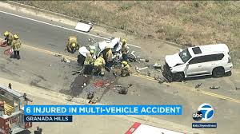

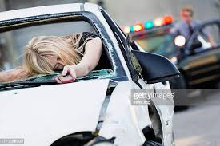
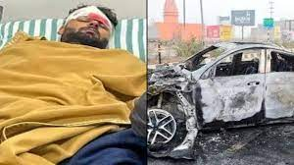
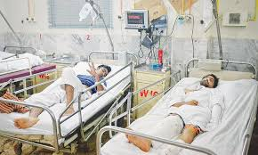


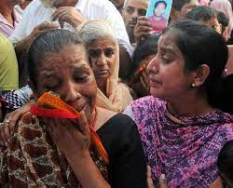
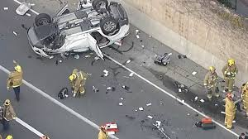

Importance of Vehicle Maintenance in the Summer Season
Accidents and Statistics
Economic Impact
Human Toll
Impact on Families
Preventive Measures and Vehicle Maintenance
What We Need to Do
Raise awareness about the importance of routine vehicle maintenance through educational campaigns, social media, and community outreach programs.- Encourage vehicle owners to adhere to manufacturer-recommended service schedules, especially before the summer season.- Promote safe driving practices, including regular breaks on long trips, avoiding distractions, and using seat belts at all times.- Advocate for stricter vehicle safety regulations and increased enforcement to prevent accidents caused by poor maintenance. Remember, regular maintenance of vehicles not only reduces the risk of accidents but also ensures a vehicle's longevity and optimal performance.
Regular vehicle maintenance is essential, especially during the summer season, to minimize the risk of accidents and breakdowns.- Adequate tire maintenance, including checking pressure and tread wear, is crucial for safe driving.- Cooling system checks, battery inspections, and regular oil changes are recommended for optimal vehicle performance in high temperatures.- Other vital components to inspect include brakes, lights, wipers, and suspension to ensure safe and efficient operation.
Each year, millions of accidents occur worldwide due to various reasons, including vehicle maintenance issues.- According to the World Health Organization (WHO), road traffic accidents result in approximately 1.35 million deaths annually.- Vehicle breakdowns and malfunctions account for a significant portion of accidents, especially during extreme weather conditions like the summer season
The loss of human life due to vehicle accidents is a tragic consequence, affecting families and communities.- In the United States alone, more than 38,000 people die each year in motor vehicle accidents, according to the National Highway Traffic Safety Administration (NHTSA).- Survivors often suffer severe physical injuries, emotional trauma, and financial burdens.
The loss of a loved one in a vehicle accident causes deep emotional and financial distress for affected families.- Families may experience prolonged grief, depression, and immense financial strain, particularly if the deceased was the sole breadwinner.- Accidents can lead to substantial legal and medical expenses, impacting the family's ability to recover and move forward.
Accidents and improper vehicle maintenance have substantial economic consequences, leading to GDP losses for nations.- The World Bank estimates that road traffic accidents cost most countries around 3% of their GDP.- These expenses include medical costs, property damage, lost productivity, and increased insurance premiums.

Slide 5
